Slide 1
Introduction to SQL
Week 05.

Slide 2
Objectives
Describe the concept of CRUD in database;
Demonstrate how to write SQL codes to perform CRUD.

Slide 3
Tools Required
MySQL DB
MySQL Workbench

Slide 4
Introduction TO DATABASE

Slide 5
What is a Database?
The next part of the Movie Review website that we are going to create is the Model.
However, before you go on you will need to understand what is a Database.
A Database is an application that stores a collection of data. It has a set of built-in library or APIs for creating, accessing, managing, searching and replicating the data that it stores.

Slide 6
Relational Database
Today, we use Relational Database Management Systems (RDBMS) to store and manage huge volume of data.
It is called Relational Database because all the data are stored into different tables and relations are created using Primary Keys and/or Foreign Keys.
Let’s look at how a table looks like in a relational database on the next slide.

Slide 7
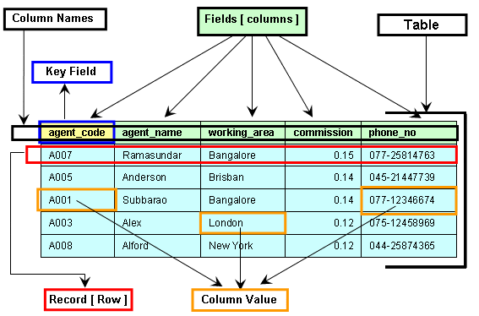
Table
A table contains data in a matrix form and it looks like a spreadsheet.

Slide 8
MySQL Database
There are many Relational Database Servers available in the market. Some are free (such as MySQL and PostgreSQL) and some are rather costly (such as Microsoft SQL and Oracle).
In this course, we will be using a free database server called MySQL.
MySQL is released under an open-source license.
Although being free, MySQL is a powerful database server that can handle large data sets, up to 50 million rows or more in a table.
It uses a standard form of SQL, and works on many operating systems and with many languages such as PHP, Java, C, C++, JavaScript, etc.

Slide 9
Creating a Database Schema
In order to store data in a database, we need to first create a database schema.
A database schema is a structure that represents the logical view of the entire database of an application. The application can be web based, mobile based, or desktop based.
The database schema is created through the design of tables and fields, and their constraints.
After a database schema is created, a database instance can be started to allow for the operation of data.
Once the database instance is operational, it is very difficult to make any changes to it.

Slide 10
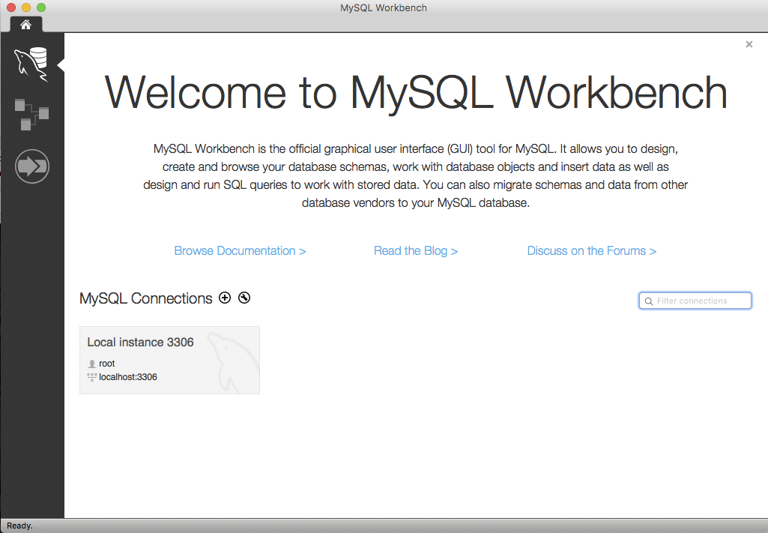
Creating a Database Schema
Your MySQL DB should have already automatically started. MySQL server runs on port 3306 by default.
Refer to the demo here
Click on this and go to slide 15. If you do not see this, go to next slide.

Slide 11
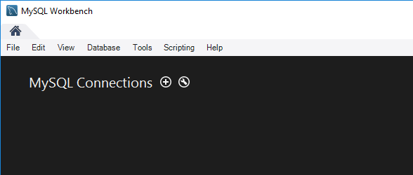
Connecting to Database
Click on the “+” sign as shown in the diagram.
Go to the next slide.

Slide 12
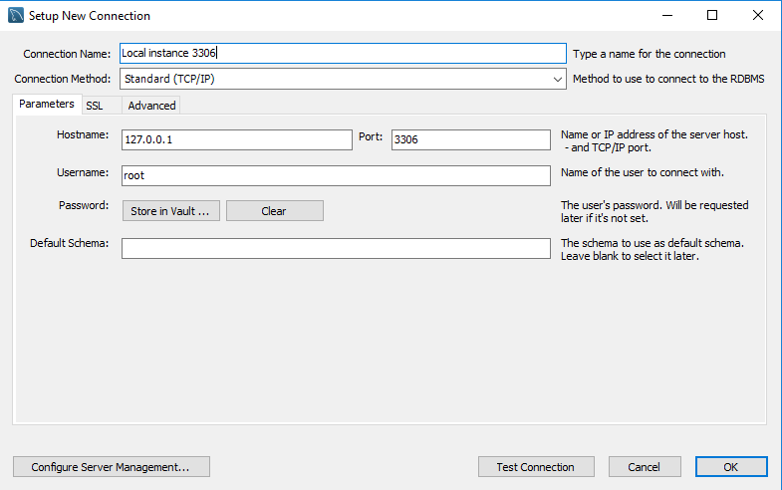
Connecting to Database
A new window will appear to setup a new connection.
For the Connection Name, enter “Local instance 3306”.
Click on Test Connection button to check if connection to database is successful.
If unsuccessful, check if your database server is up and running.
If successful, click on OK button then go to slide 12.

Slide 13
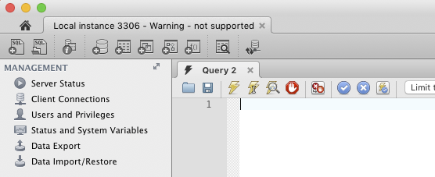
Creating a Database Schema
Once connected, you will see a similar window as shown here.
As a practice, create a new schema by clicking on the icon as shown.
Click on this.

Slide 14
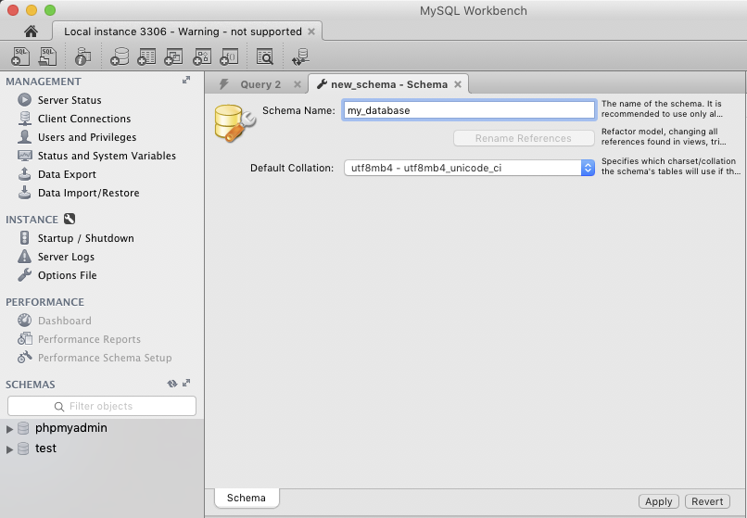
Creating a Database Schema
A “new_schema” tab will appear.
For Schema Name, enter my_database.
For Default Collation, select utf8mb4 – utf8mb4_Unicode_ci.
The Default Collation allows you to store data in different character encodings.
By selecting utf8mb4 – utf8mb4_Unicode_ci, your database will be able to store Asian characters such as Chinese, Korean and Japanese.
Click the Apply button.

Slide 15
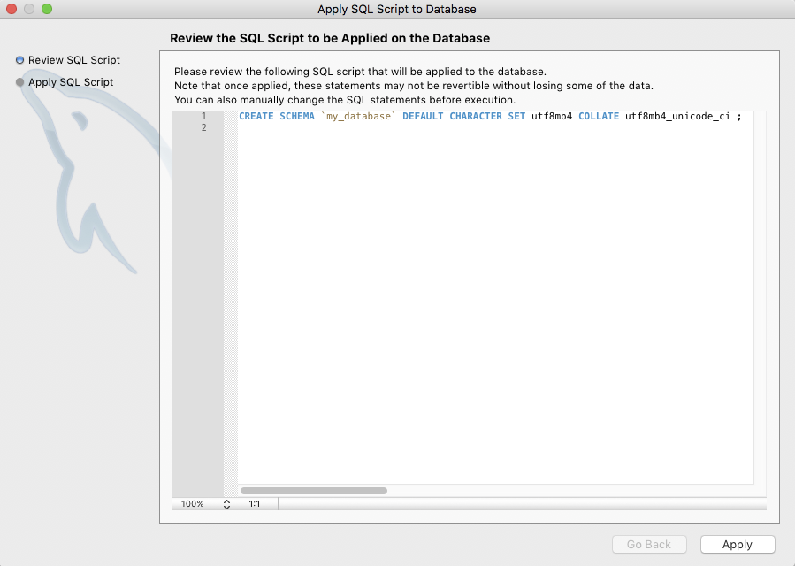
Creating a Database Schema
In this window the SQL codes for creating schema is shown. Study the codes and click the Apply button when you’re done.
CREATE SCHEMA ‘my_database’ DEFAULT CHARACTER SET utf8mb4 COLLATE utf8mb4_unicode_ci;

Slide 16
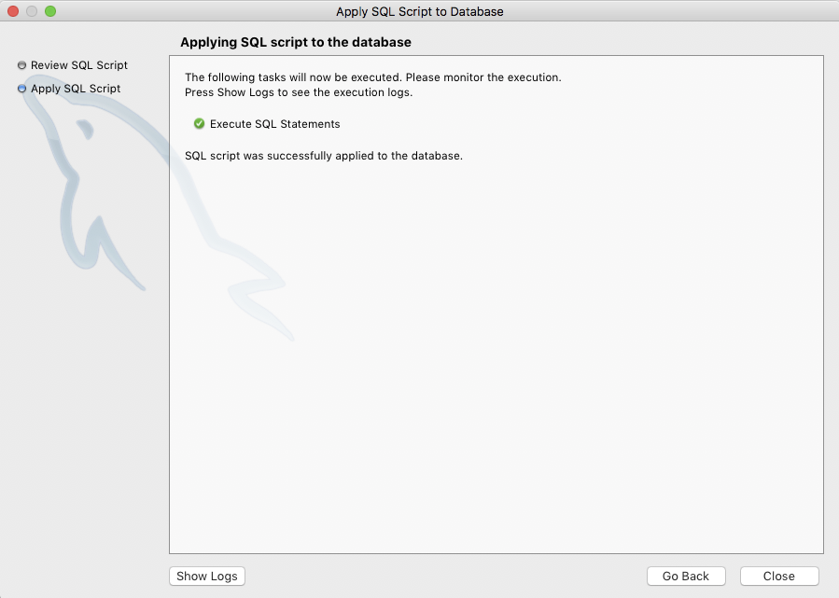
Creating a Database Schema
In this window, click on the Close button.

Slide 17
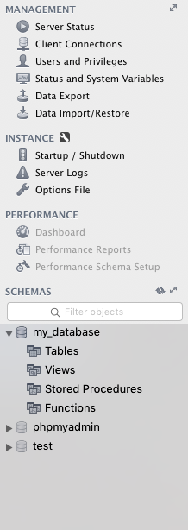
Adding Acknowledgement Modal Window
In the left panel, under SCHEMAS, you should see my_database appear.

Slide 18
Introduction TO SQL

Slide 19
What is SQL?
SQL (Structured Query Language) is a language to operate databases.
It includes database creation, deletion, fetching rows, modifying rows, etc.
SQL is an ANSI (American National Standards Institute) standard language, but there are many different versions of the SQL language.
SQL is the standard language for Relational Database System.

Slide 20
Why SQL?
SQL is widely popular because it offers the following advantages :−
Allows users to access data in the relational database management systems.
Allows users to describe the data.
Allows users to define the data in a database and manipulate that data.
Allows to embed within other languages using SQL modules, libraries & pre-compilers.
Allows users to create and drop databases and tables.
Allows users to create view, stored procedure, functions in a database.
Allows users to set permissions on tables, procedures and views.

Slide 21
A Brief History of SQL
1970 − Dr. Edgar F. "Ted" Codd of IBM is known as the father of relational databases. He described a relational model for databases.
1974 − Structured Query Language appeared.
1978 − IBM worked to develop Codd's ideas and released a product named System/R.
1986 − IBM developed the first prototype of relational database and standardized by ANSI. The first relational database was released by Relational Software which later came to be known as Oracle.

Slide 22
Data Types - MySQL
Properly defining the fields in a table is important to the overall optimization of your database.
You should use only the type and size of field you really need to use. For example, do not define a field 10 characters wide, if you know you are only going to use 2 characters.
These type of fields (or columns) are also referred to as data types, base on the type of data you will be storing in those fields.
MySQL uses many different data types broken into three categories −
Numeric
Date and Time
String Types.

Slide 23
Numeric Data Types
The following list shows the common numeric data types and their descriptions:
Data Types | Description
INT | A normal-sized integer that can be signed or unsigned. If signed (ie. allow negative), the allowable range is from -2147483648 to 2147483647. If unsigned, the allowable range is from 0 to 4294967295. You can specify a width of up to 11 digits.
TINYINT | A very small integer that can be signed or unsigned. If signed, the allowable range is from -128 to 127. If unsigned, the allowable range is from 0 to 255. You can specify a width of up to 4 digits.
FLOAT (M, D) | A floating-point number that cannot be unsigned. You can define the display length (M) and the number of decimals (D). This is not required and will default to 10,2, where 2 is the number of decimals and 10 is the total number of digits (including decimals). Decimal precision can go to 24 places for a FLOAT.
DOUBLE (M, D) | A double precision floating-point number that cannot be unsigned. You can define the display length (M) and the number of decimals (D). This is not required and will default to 16,4, where 4 is the number of decimals. Decimal precision can go to 53 places for a DOUBLE. REAL is a synonym for DOUBLE.

Slide 24
Date and Time Data Types
The MySQL date and time datatypes are as follows:
Data Types | Description
DATE | A date in YYYY-MM-DD format, between 1000-01-01 and 9999-12-31. For example, December 30th, 1973 would be stored as 1973-12-30.
DATETIME | A date and time combination in YYYY-MM-DD HH:MM:SS format, between 1000-01-01 00:00:00 and 9999-12-31 23:59:59. For example, 3:30 in the afternoon on December 30th, 1973 would be stored as 1973-12-30 15:30:00.
TIMESTAMP | A timestamp between midnight, January 1st, 1970 and sometime in 2037. This looks like the previous DATETIME format, only without the hyphens between numbers; 3:30 in the afternoon on December 30th, 1973 would be stored as 19731230153000 ( YYYYMMDDHHMMSS ).
TIME | Stores the time in a HH:MM:SS format.
YEAR(M) | Stores a year in a 2-digit or a 4-digit format. If the length is specified as 2 (for example YEAR(2)), YEAR can be between 1970 to 2069 (70 to 69). If the length is specified as 4, then YEAR can be 1901 to 2155. The default length is 4.

Slide 25
String Data Types
This list describes the common string datatypes in MySQL:
Data Types | Description
CHAR(M) | A fixed-length string between 1 and 255 characters in length (for example CHAR(5)), right-padded with spaces to the specified length when stored. Defining a length is not required, but the default is 1.
VARCHAR(M) | A variable-length string between 1 and 255 characters in length. For example, VARCHAR(25). You must define a length when creating a VARCHAR field.
BLOB or TEXT | A field with a maximum length of 65535 characters. BLOBs are "Binary Large Objects" and are used to store large amounts of binary data, such as images or other types of files. Fields defined as TEXT also hold large amounts of data. The difference between the two is that the sorts and comparisons on the stored data are case sensitive on BLOBs and are not case sensitive in TEXT fields. You do not specify a length with BLOB or TEXT.
TINYBLOB or TINYTEXT | A BLOB or TEXT column with a maximum length of 255 characters. You do not specify a length with TINYBLOB or TINYTEXT.
MEDIUMBLOB or MEDIUMTEXT | A BLOB or TEXT column with a maximum length of 16777215 characters. You do not specify a length with MEDIUMBLOB or MEDIUMTEXT.
LONGBLOB or LONGTEXT | A BLOB or TEXT column with a maximum length of 4294967295 characters. You do not specify a length with LONGBLOB or LONGTEXT.
ENUM | An enumeration, which is a fancy term for list. When defining an ENUM, you are creating a list of items from which the value must be selected (or it can be NULL). For example, if you wanted your field to contain “START" or “STOP" or “PAUSE", you would define your ENUM as ENUM (‘START', ‘STOP', ‘PAUSE') and only those values (or NULL) could ever populate that field.

Slide 26
Creating Table
In order to store data, we need to create tables, each for a particular set of data.
Creating a table requires the following details:
Name of the table
Name of the fields
The field to be the primary key

Slide 27
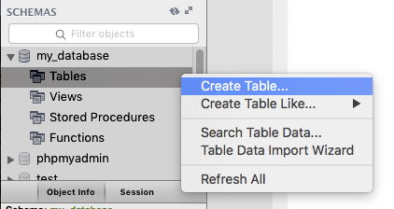
Creating Table
To create a table in MySQL Workbench, right click on the Tables item under my_database and click on Create Table….

Slide 28
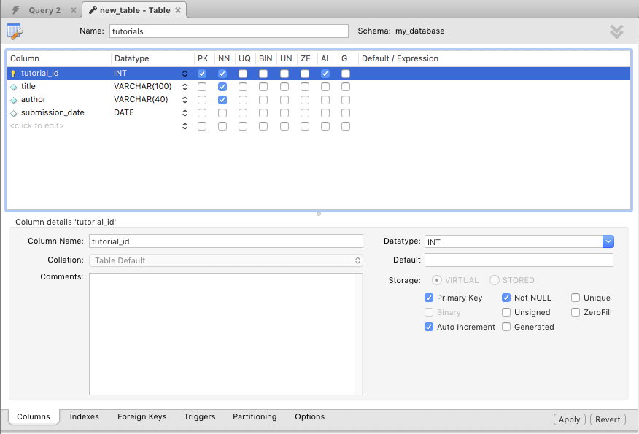
Creating Table
In the new_table tab, enter the following information:
Table Name: tutorials
Column Details:
Below are explanation for the above:
Field Attribute NOT NULL is being used because we do not want this field to be NULL. So, if a user will try to create a record with a NULL value, then MySQL will raise an error.
Field Attribute AUTO_INCREMENT tells MySQL to go ahead and add the next available number to the id field.
Keyword PRIMARY KEY is used to define a column as a primary key. You can use multiple columns separated by a comma to define a primary key.
Click Apply button after you’re done.
Columns | Data Type | Remarks
tutorial_id | INT | Primary Key (PK) Not Null (NN) Auto Increment (AI)
title | VARCHAR(100) | Not Null (NN)
author | VARCHAR(40) | Not Null (NN)
submission_date | DATE

Slide 29
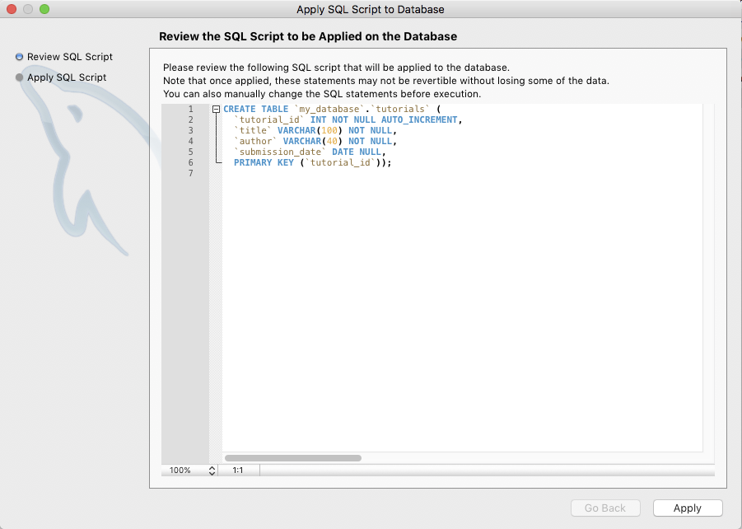
Creating Table
In this window, the SQL code for creating the table is shown. Study the codes and click Apply after you’re done.
CREATE TABLE ‘my_database’.’tutorials’ (
‘tutorial_id’ INT NOT NULL AUTO_INCREMENT,
‘title’ VARCHAR(100) NOT NULL,
‘author’ VARCHAR(40) NOT NULL,
‘submission_date’ DATE NULL,
PRIMARY KEY (‘tutorial_id’));

Slide 30
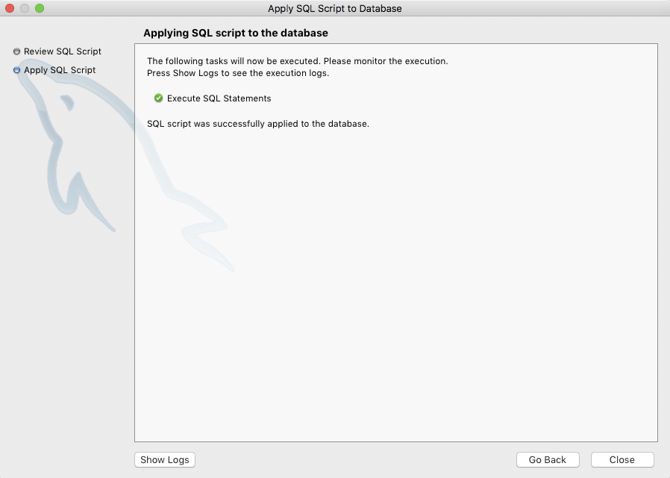
Creating Table
In this window, click Close.

Slide 31
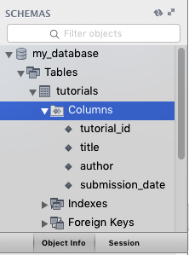
Creating Table
When the table is successfully created, you will see the table under my_database in the left panel
Click on Columns to see the fields that you created.

Slide 32
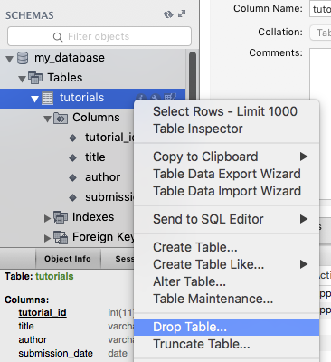
Drop Table
In SQL, deleting a table is known as drop table.
To drop a table, just right click on the table and choose Drop Table… as shown here.

Slide 33
Insert Query
To insert data into the table, you need to run a SQL code to do so.
The generic SQL syntax for INSERT data is as follows:
You will need to type the SQL codes into the query editor in MySQL Workbench on the next slide.
INSERT INTO table_name ( field1, field2, field3, …) VALUES (value1, value2, value3);

Slide 34
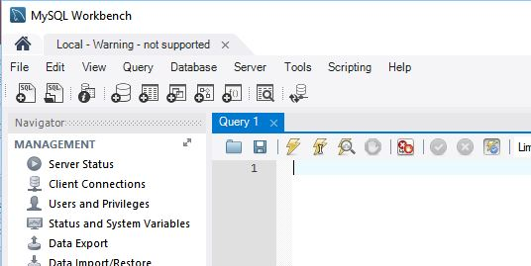
Insert Query
Click on the query tab as shown here. Your tab may be named as Query 1.
You will insert the following data into the table:
The next slide will show you how to insert the first record.
title | author | submission_date
“Learn PHP” | “John Paul” | NOW()
“Learn MySQL” | “Abdul S” | NOW()
“Java Tutorial” | “Lim Ko Pi” | ‘2007-05-11’

Slide 35
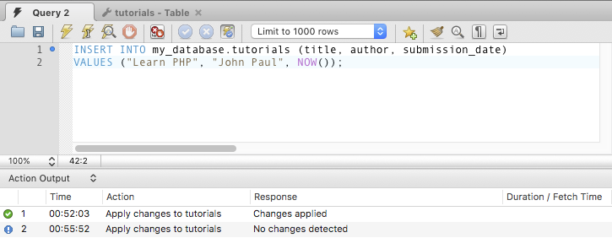
Insert Query
Enter the codes into the query editor as shown here and click on the lightning icon to execute the codes.
Look at the Action Output window to see if it is successful.

Slide 36
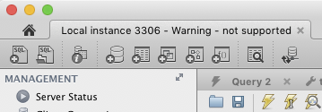
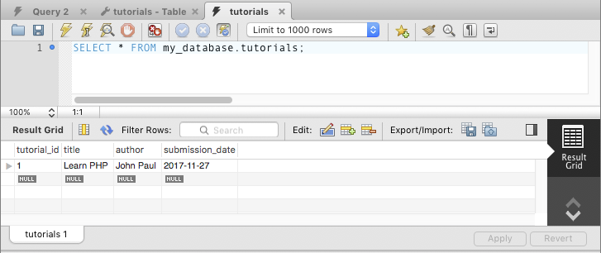
Insert Query
If there is no error, you can click on this icon to open another query editor window and enter the SELECT query below.
Click on the lightning icon to execute the codes.
Your inserted data will appear in the Result Grid.
SELECT * FROM my_database.tutorials;

Slide 37
Try it!
Insert the rest of the data into the table and check to see if they are inserted by using the same SELECT codes.

Slide 38
SELECT Query
The SQL SELECT command is used to fetch data from the MySQL database.
The generic SQL syntax for SELECT data is as follows:
Try to execute the following SELECT code to see the result:
The ‘*’ is used to select all records from the table:
SELECT field1, field2, field3,… FROM database.table1, database.table2,…;
SELECT title, author FROM my_database.tutorials;
SELECT * FROM my_database.tutorials;

Slide 39
SELECT Query – WHERE Clause
We can use a conditional clause called the WHERE Clause to filter out the results. Using this WHERE clause, we can specify a selection criteria to select the required records from a table.
The generic syntax for WHERE clause in SELECT statement is:
Try to execute the following codes to see the result:
SELECT field1, field2, field3,… FROM database.table1, database.table2,…
[WHERE condition1] [AND | OR] condition2…;
SELECT * FROM my_database.tutorials WHERE author = ‘Lim Ko Pi’;

Slide 40
Try it!
Try to find the result for the following two problems:
Retrieve the author and submission date where the title is ‘Learn MySQL’.
Select author, submission_date from my_database.tutorials where title = "Learn MySQL";
What is the submission date where the author is Abdul S and the title is Learn MySQL?
Select submission_date from my_database.tutorials where author = "Abdul S";

Slide 41
UPDATE Query
There may be a requirement where the existing data in a MySQL table needs to be modified. You can do so by using the SQL UPDATE command. This will modify any field value of any MySQL table.
The generic syntax for UPDATE command is:
Execute the following SQL code to see the result:
UPDATE database.table SET field1 = new_value1, field2 = new_value2,… [WHERE clause];
UPDATE my_database.tutorials SET title = ‘Learning Java’ WHERE tutorial_id = 3;

Slide 42
Try It!
Update the author for ‘Learn MySQL’ to ‘Abdul Ismail’.
Update my_database.tutorials set author = "Abdul Ismail" where tutorial_id = 3;
Update my_database.tutorials set author = "Abdul Ismail" where
my_database.title = "Learn MySQL";

Slide 43
Delete Query
If you want to delete a record from any MySQL table, then you can use the SQL command DELETE FROM.
The generic syntax for DELETE FROM command is:
Try to execute the following codes to see the result:
DELETE FROM database.table [WHERE clause];
DELETE FROM my_database.tutorials WHERE tutorial_id = 3;

Slide 44
LIKE Clause
We have seen the SQL SELECT command to fetch data from the MySQL table.
We can also use a conditional clause called as the WHERE clause to select the required records.
A WHERE clause with the ‘equal to’ sign (=) works fine where we want to do an exact match.
But there may be a requirement where we want to filter out all the results where author name should contain "jay".
This can be handled using SQL LIKE Clause along with the WHERE clause.
The generic syntax for LIKE clause is:
SELECT field1, field2, field3,… FROM database.table1, database.table2,…
WHERE field1 LIKE condition1 [AND | OR] field2 = …;

Slide 45
LIKE Clause
Execute the following SQL code to see the result:
SELECT * FROM my_database.tutorials WHERE author LIKE ‘%mail’;

Slide 46
Sorting Results
We have seen the SQL SELECT command to fetch data from a MySQL table.
When you select rows, the MySQL server is free to return them in any order, unless you instruct it otherwise by saying how to sort the result.
But, you sort a result set by adding an ORDER BY clause that names the column or columns which you want to sort.
The generic syntax for ORDER BY clause is:
In the above ASC = Ascending; DESC = Descending.
Insert two more records with your preferred data. Then execute the following to see the result:
SELECT field1, field2, field3,… FROM database.table1, database.table2,…
ORDER BY field1, field2,… [ASC | DESC];
SELECT * FROM my_database.tutorials ORDER BY author ASC;

Slide 47
Normalization (1NF, 2NF)

Slide 48
First Normal Form (1NF)
The database table is in first normal form only if the domain of each attribute contains a single value
EmployeeID | FirstName | LastName | ContactNumber
1 | Susan | Tan | 91800000, 67811111
2 | Peter | Davidson | 92822222, 67811112
1NF ?
EmployeeID | FirstName | LastName | ContactNumber1 | ContacNumber2
1 | Susan | Tan | 91800000 | 67811111
2 | Peter | Davidson | 92822222 | 67811112

Slide 49
First Normal Form (1NF)
But what if employees have more than 2 contact numbers? Should there be a limit to how many contact numbers an employee can have?
1NF
EmployeeID | FirstName | LastName
1 | Susan | Tan
2 | Peter | Davidson
ID | EmployeeID | ContactNumber
1 | 1 | 91800000
2 | 1 | 67811111
3 | 2 | 92822222
4 | 2 | 67811112
5 | 2 | 67533334

Slide 50
Second Normal Form (2NF)
If a relation/table is in 2NF, then it is in 1NF too
This is not in 2NF because the “DepartmentHead” is dependent on the “Department”, it has nothing to do with the other information
Thus, we have duplicate information – several rows telling us the head of IT is “Peter”
EmployeeID | Name | Gender | Salary | Department | DepartmentHead
1 | Ninja | M | 2500 | HR | Raju
2 | Meili | F | 7000 | IT | Peter
3 | Siti | F | 5000 | IT | Peter
4 | Ali | M | 8000 | IT | Peter

Slide 51
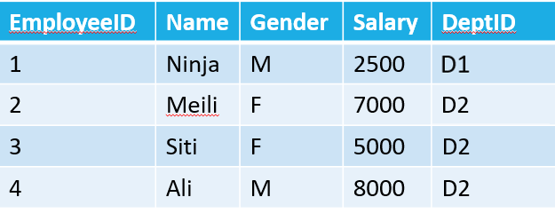
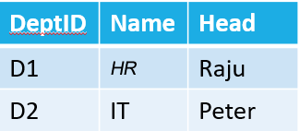
Third Normal Form (3NF)
So we fix it by moving the “Department” and “DepartmentHead” into another table and adding a DeptID as primary key

Slide 52
Reference
TutorialsPoint – Learn MySQL
https://www.tutorialspoint.com/mysql/index.htm

Slide 53
The End

